Slide 1
Chemicals In
Cosmetics
By Etienne Batiste
CS 2316
Fall 2020

Slide 2
About the Project
I chose this topic because of interest in the safety of ingredients found in cosmetics. I am looking to learn how many products currently being sold have potentially hazardous chemicals in them.
The goal is to also gather knowledge about the safety of specific ingredients found in products and to trace potentially hazardous chemicals back to specific brands that are selling them.
Notes:
○ Point of interest and purpose

Slide 3
The Method
Clean the Data
Data Analysis
Gather Insights
Results

Slide 4

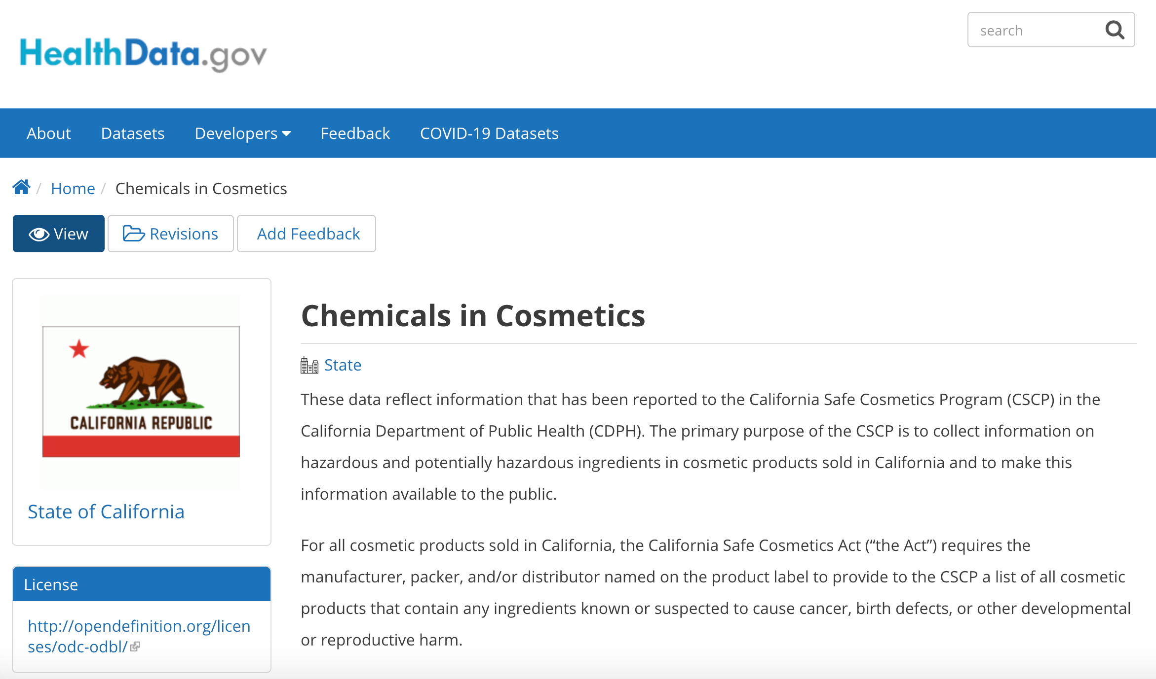
Finding and Cleaning the Data
“Chemicals in Cosmetics” dataset from HealthData.gov
Cosmeticsinfo.gov’s alphabetized ingredients list
Notes:
○ Data collection process
○ How you found your dataset(s)
found dataset by searching Health.gov for data relating to cosmetics. We also wanted to find a site that contained an abundance of information about cosmetic ingredients which led us to cosmeticsinfo.org. Lastly we searched for data about organic products which can be found in the Makeup API.

Slide 5
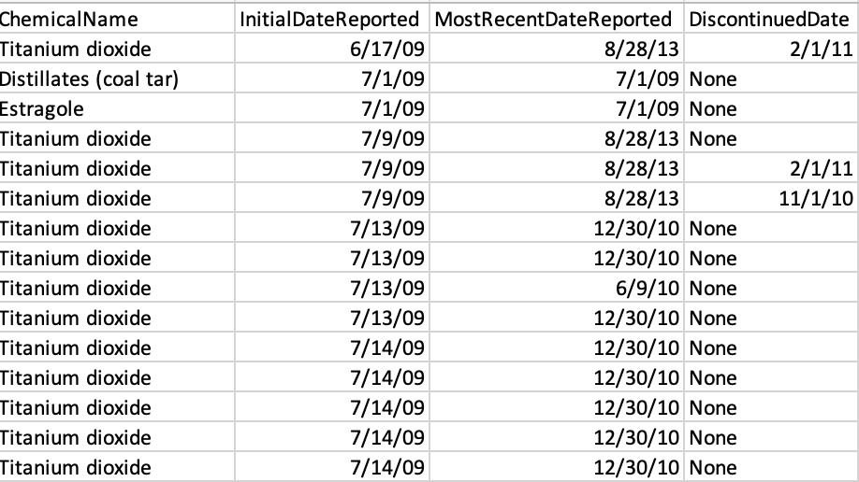
Finding and Cleaning the Data
Significant number of empty strings. To fix, we must fill those empty strings with "Unknown" or "None" where they fit appropriately.
Significant duplicate rows. We must use .drop_duplicates() method to fix.
Notes:
○ Data cleaning process

Slide 6
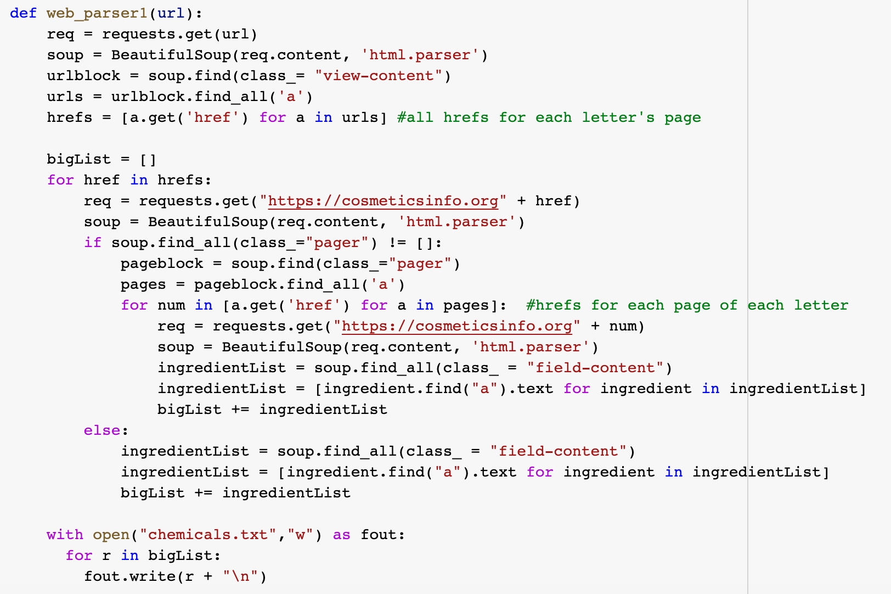
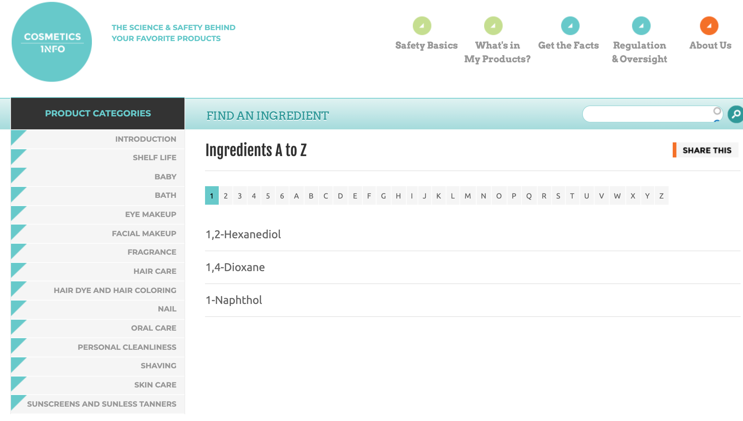
Finding and Cleaning the Data
Some indices have multiple pages while others did not.
Conditionals were used to ensure the code would run for each case.
Notes:
○ Data cleaning process
had to make sure I wasn't doing too many requests on the site for ethical standards.

Slide 7
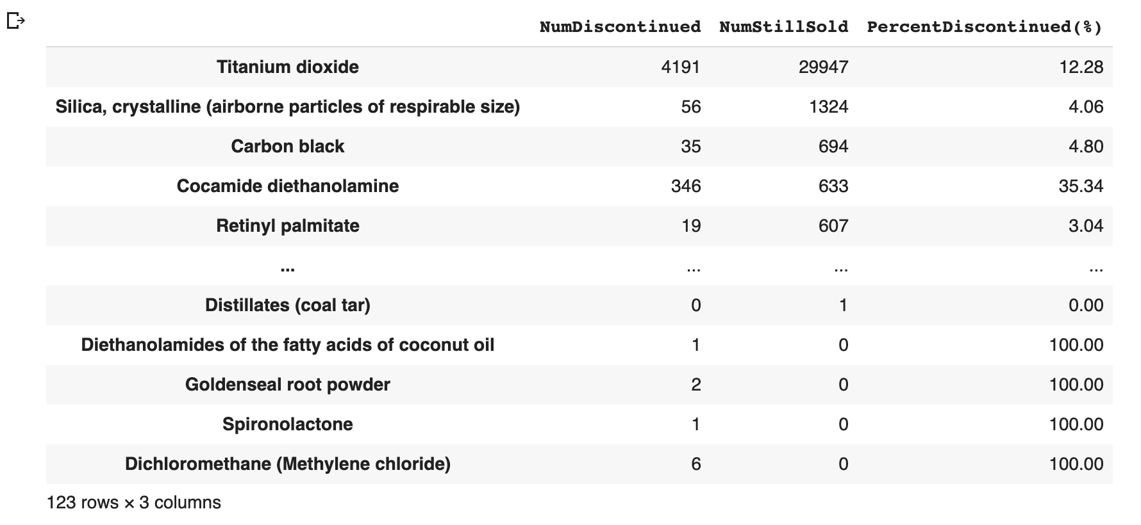
Analysis
Insight 1 identifies currently available products and discontinued products by chemical.
It can be inferred that the “percent discontinued” is proportional to the safety of the chemical.
The chemicals are sorted by number of products still sold since they are the most prevalent in cosmetics today.
Doing this also indicates that the chemicals located further down on the table are never or rarely sold which can indicate its danger.
Notes:
added a percent discontinued column to put in perspective how much the proportion of products that contain that chemical have been discontinued.

Slide 8
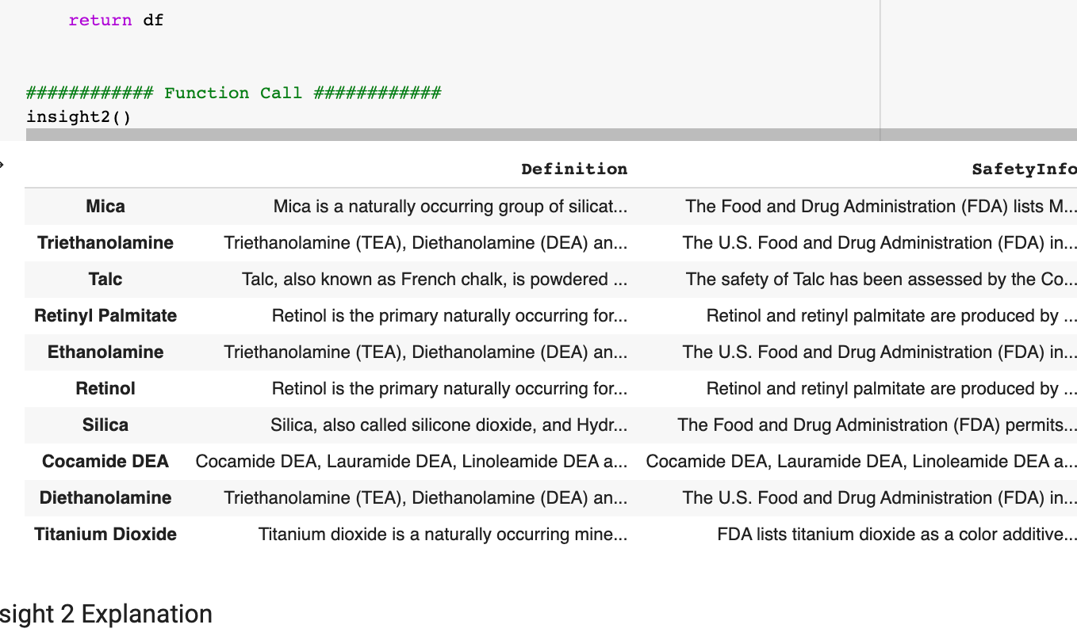
Analysis
Insight 2 serves as connection between the cleaned "chemincos.csv" (chemicals in cosmetics) file and the web. This analysis chooses the 10 most common chemicals found in products still being sold (found from the insight(1)) and uses those chemical names to find matching chemicals on the cosmeticsinfo.org website.
It then returns a definition and safety info and quick way to see if the chemical is safe by checking if key words such as "approved", "allowed" and "permitted" are contained in the safety info. If not you can read the safety info or use the link.

Slide 9
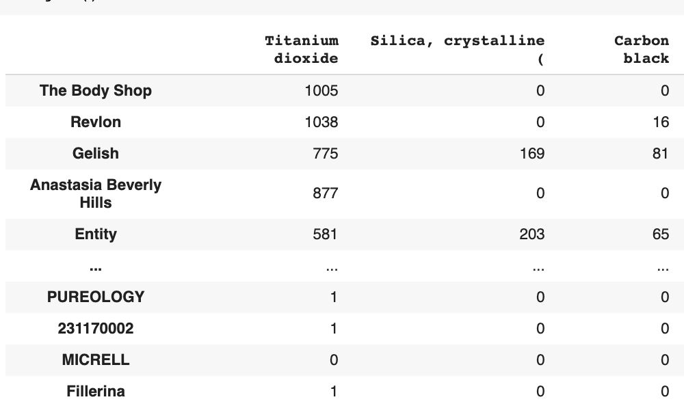
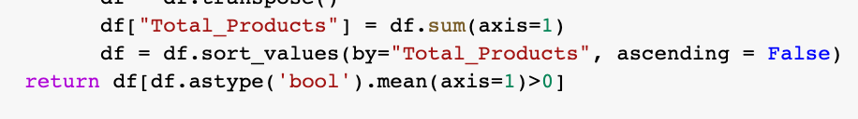
Analysis
Insight 3 finds the number of products each brand has that contains a certain "most common" chemical. We created a Total Products column (not pictured) that sums the products of each brand with these chemicals.
From this insight we are able to see which brands use which chemicals and which brands have the most products with chemicals by ordering our total products column as descending.
This insight is helpful with deciphering which brand you should look more closely at their ingredients. If they are high on the list they sell many products with one or more chemicals in it.

Slide 10
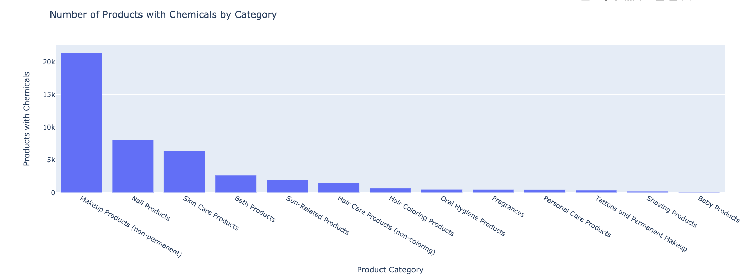
Visualization
Visualization 1 shows the number of products that contain chemicals by product category. The insights it reveals is that “makeup products” overwhelming contain chemicals compared to, for example, baby products.

Slide 11
Results and Conclusions
Titanium Dioxide is the most common chemical found in cosmetics that are being sold today.
However, our research suggests it is safe to use in small quantities.
“The Body Shop” sells the most products found with these common chemicals.
The most commonly found chemicals in cosmetics sold today are safe.
The most common harmful chemical found in the data set was “Isopropyl alcohol” manufactured using strong acids.

